Slide 1
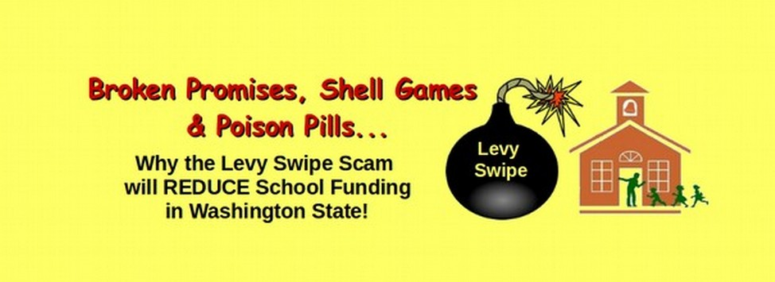
Coalition to Protect our Public Schools
School Funding Presentation
David Spring, M.Ed.
For more information, see our special report available at
https://coalitiontoprotectourpublicschools.org/

Slide 2
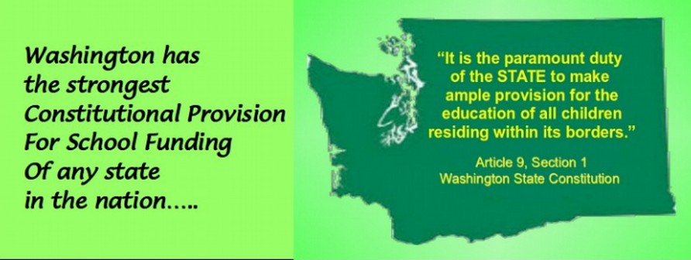
In 1889, the 75 drafters of the
Washington State Constitution approved
the provision making the AMPLE funding of
our Public Schools the Paramount Duty of the State.
The vote was 73 to 2 in favor.

Slide 3
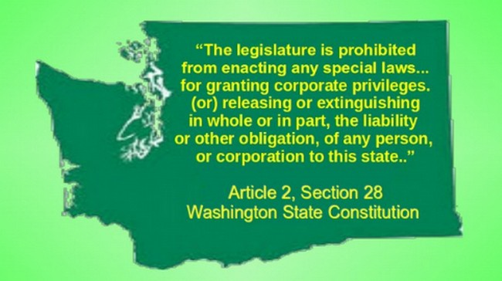
To protect against the possibility of a corrupt legislature, they also provided for a
Supreme Court elected directly by the people...
To insure that our
Schools were
amply funded,
They also added a
Provision
Prohibiting
tax breaks
To any person
Or corporation.

Slide 4
Sadly, for the past 20 years,
our state legislature has ignored
both their Paramount Duty to fund our schools
and the Constitutional prohibition against
special tax breaks for the rich.

Slide 5
As a result, today, half of our schools –
more than 1,000 schools –
do not meet either the earthquake codes
or health codes – resulting in a $40 billion
school construction & repair backlog.

Slide 6
Meanwhile, the legislature has passed
more than 700 (illegal) tax breaks for the rich.
They now give away more than $30 billion per year
in tax breaks for the rich.

Slide 7
In 2007, a group of school funding advocates
called the NEWS Coalition sued the State
for failing to meet their Paramount Duty
To Amply fund our schools.

Slide 8
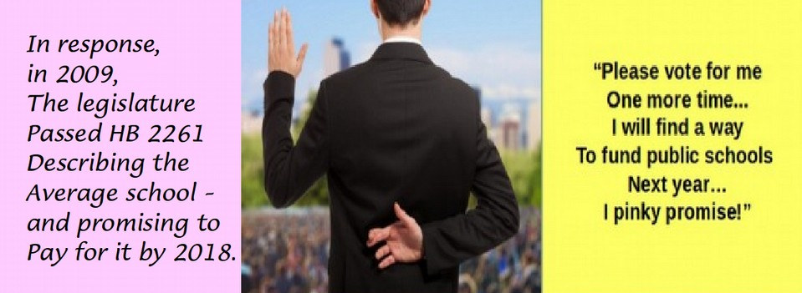
In 2009, a King County judge agreed.
He ordered the State to first determine
the actual cost of fully funding schools -
and then to provide ample funds to cover this cost.

Slide 9
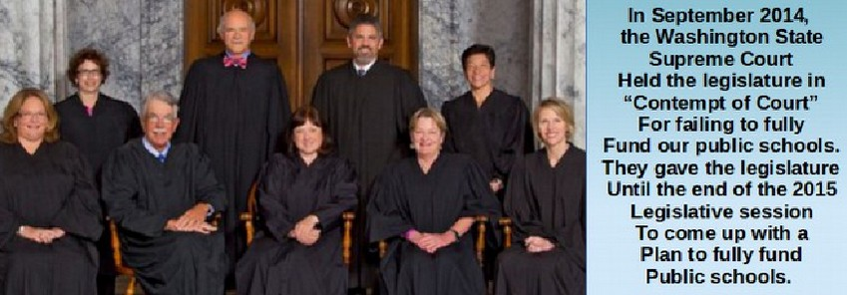
In June 2012, a report was issued
calculating that the additional cost
to keep the promises made in House Bill 2261
was $6.6 billion per year (about $7 billion today).

Slide 10
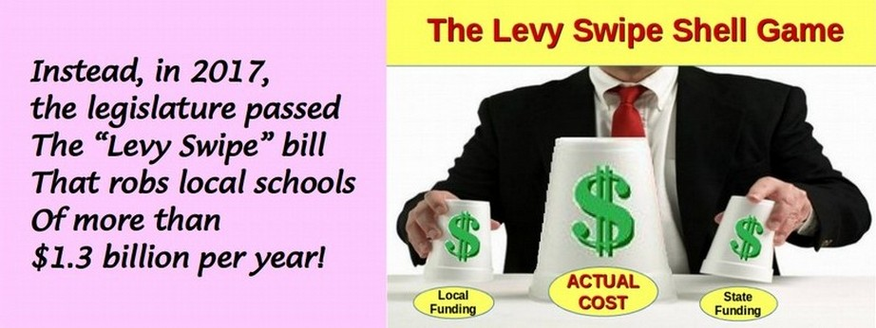
In 2017, the legislature
abandoned House Bill 2261
& broke their $7 billion per year promise.

Slide 11
The legislature falsely claimed that
the Levy Swipe would provide $8 billion
in additional school funding.
Instead, after 2018, school funding will drop!

Slide 12
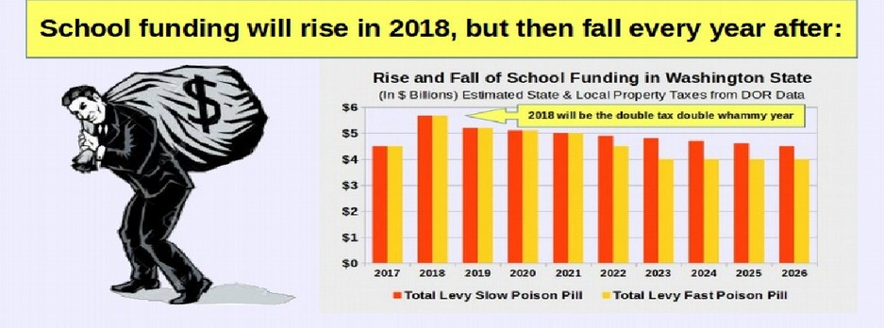
School funding will drop due to
Two Poison Pills inserted into the Levy Swipe bill.
These poison pills are described in detail
in our free report.

Slide 13
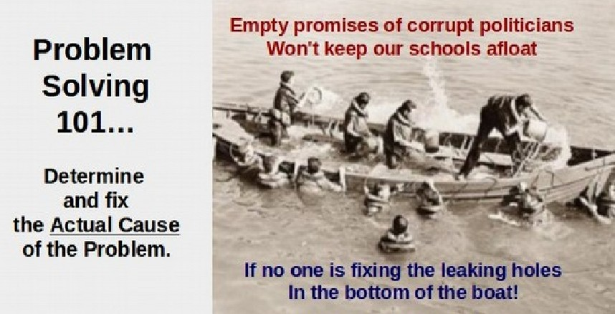
So how do we solve the School Funding
problem in Washington state?

Slide 14
If we repealed all 700 illegal tax breaks,
would could double school funding,
build hundreds of schools and
cut class sizes in half.

Slide 15
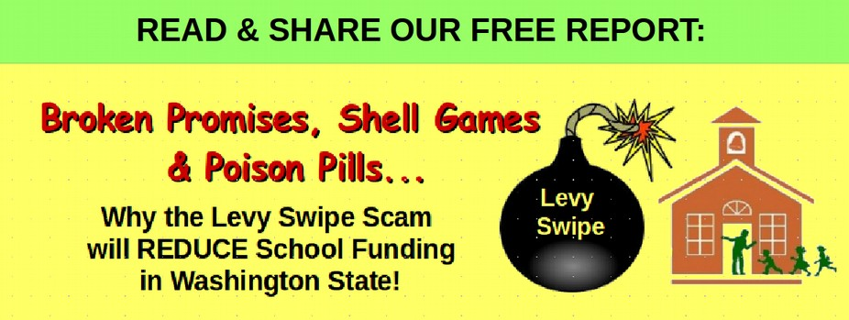
If every parent and every teacher
better understood this problem and solution,
the legislature would be forced to repeal
these illegal tax breaks.

Slide 16
Share this presentation with your local PTA…
Our kids are counting on us to restore school funding!
For more information, visit our website:
https://coalitiontoprotectourpublicschools.org/

